Slide 1

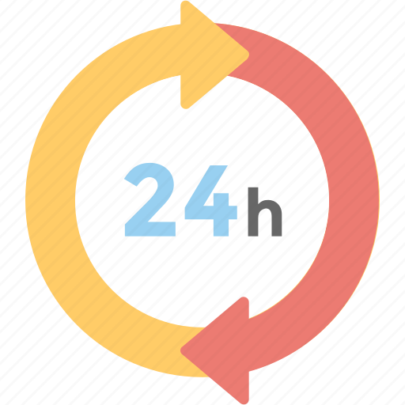
24-HOUR FORECAST
09-11-2022 @ 1200 UTC
Department of Meteorology and Climate Science,
KNUST

Slide 2
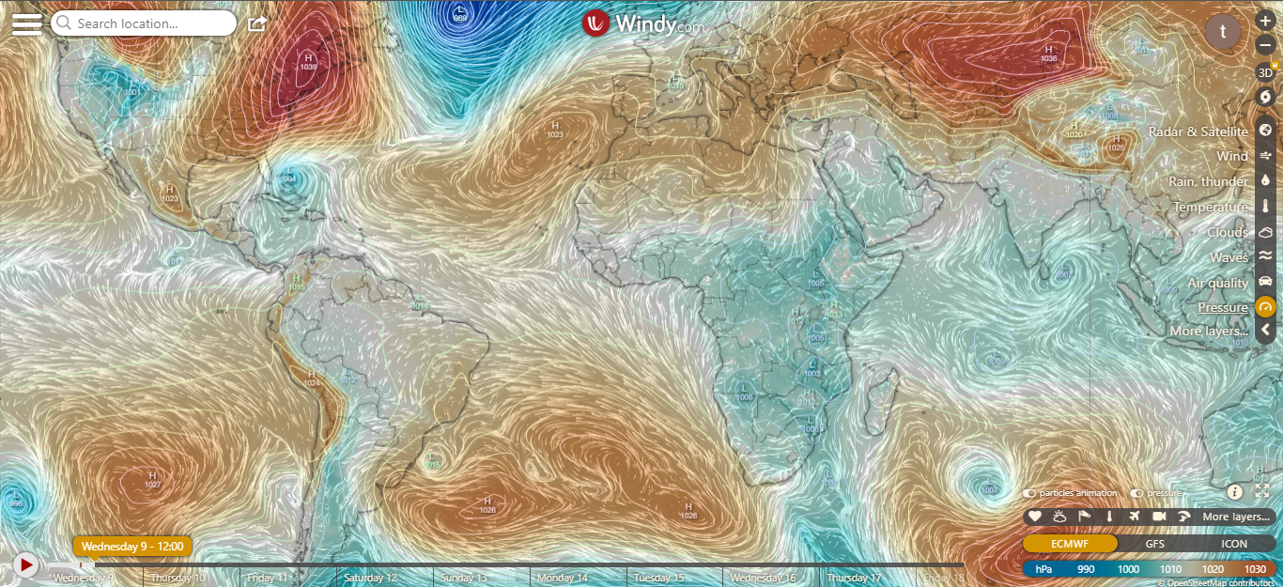
PRESSURE SYSTEMS @ 1200 UTC
1022hPa
1025hPa

Slide 3
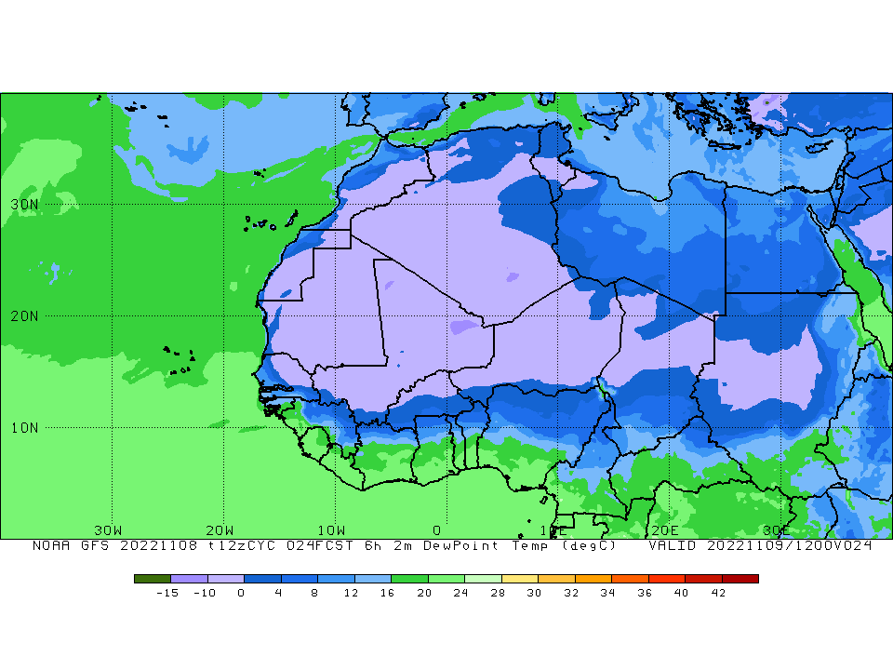
ITD POSITION @ 1200 UTC
6.8ºN

Slide 4
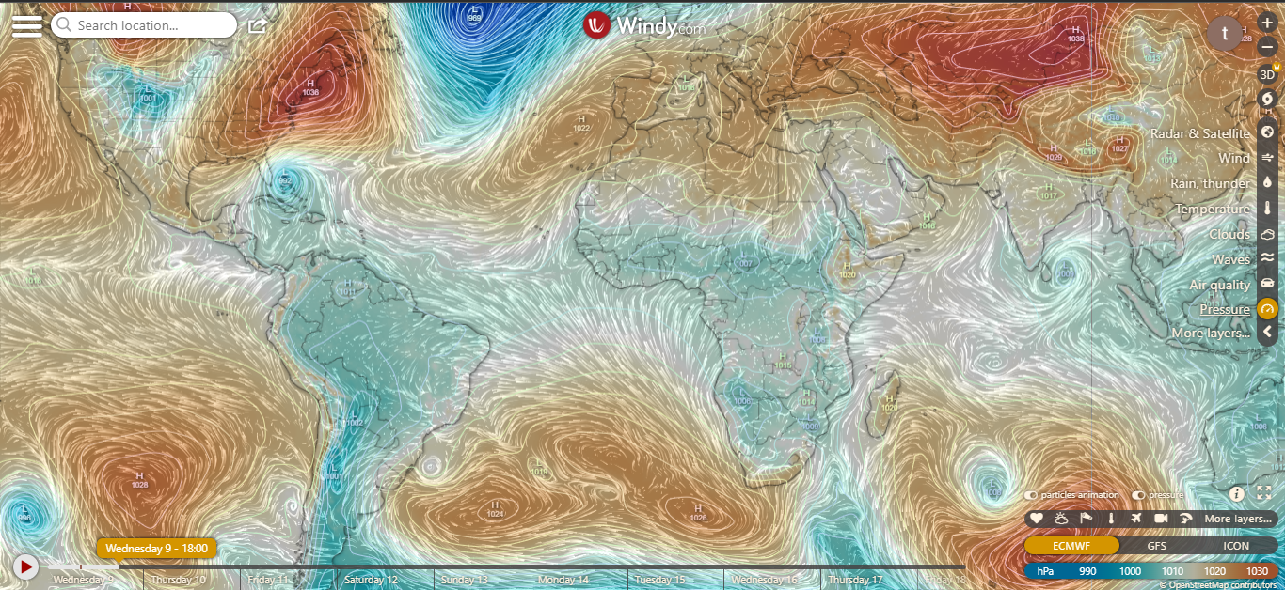
PRESSURE SYSTEMS @ 1800 UTC
1019hPa
1024hPa

Slide 5
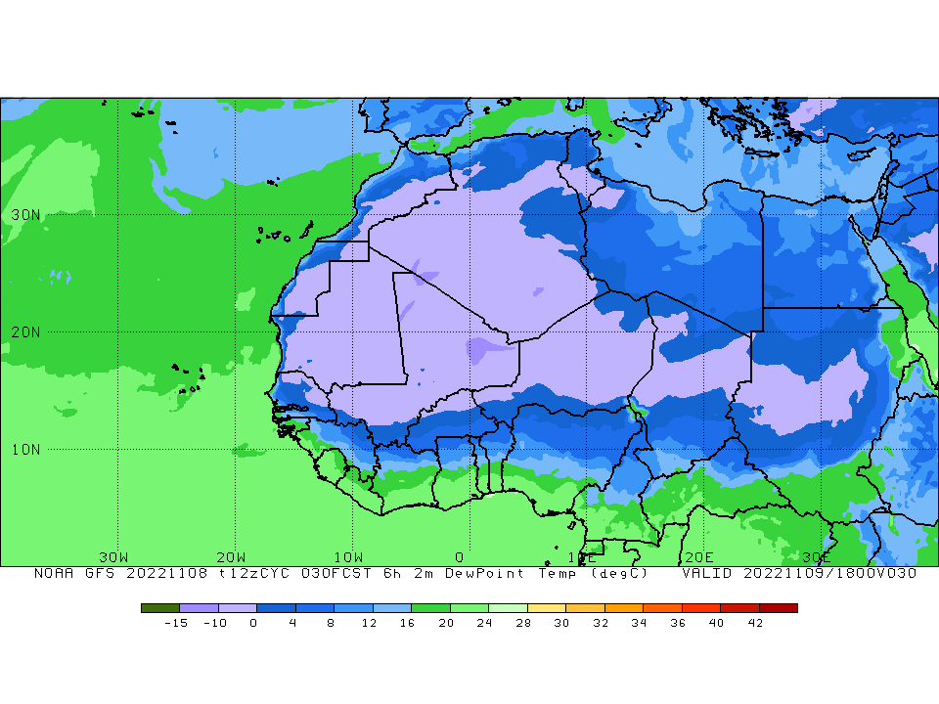
ITD POSITION @ 1800 UTC
6.8ºN

Slide 6
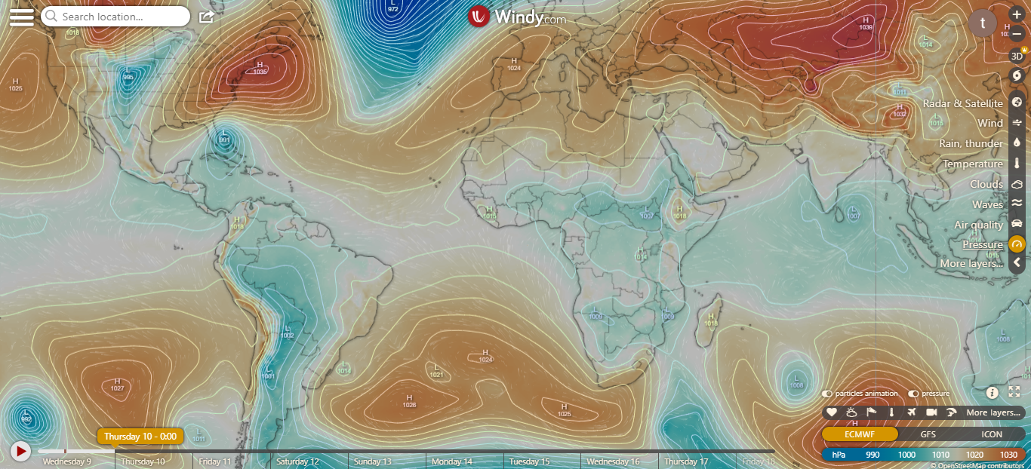
PRESSURE SYSTEMS @ 0000 UTC
1018hPa
1024hPa

Slide 7
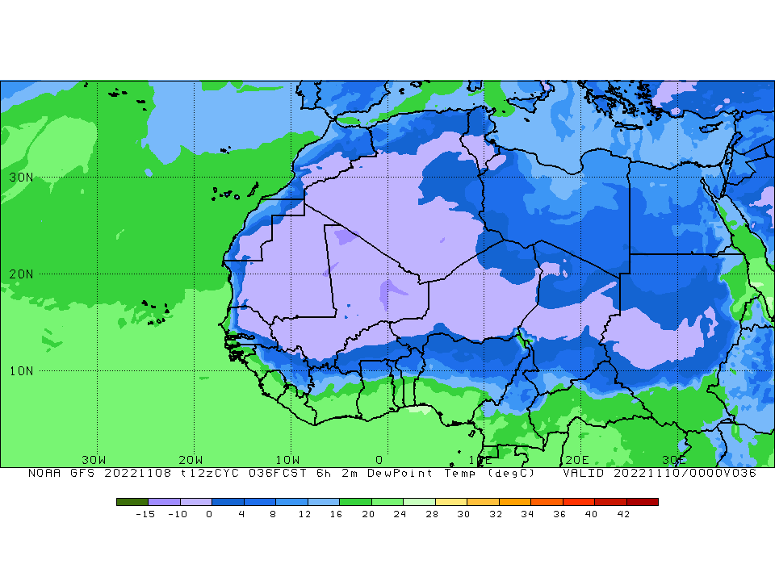
ITD POSITION @ 0000 UTC
7.0ºN

Slide 8
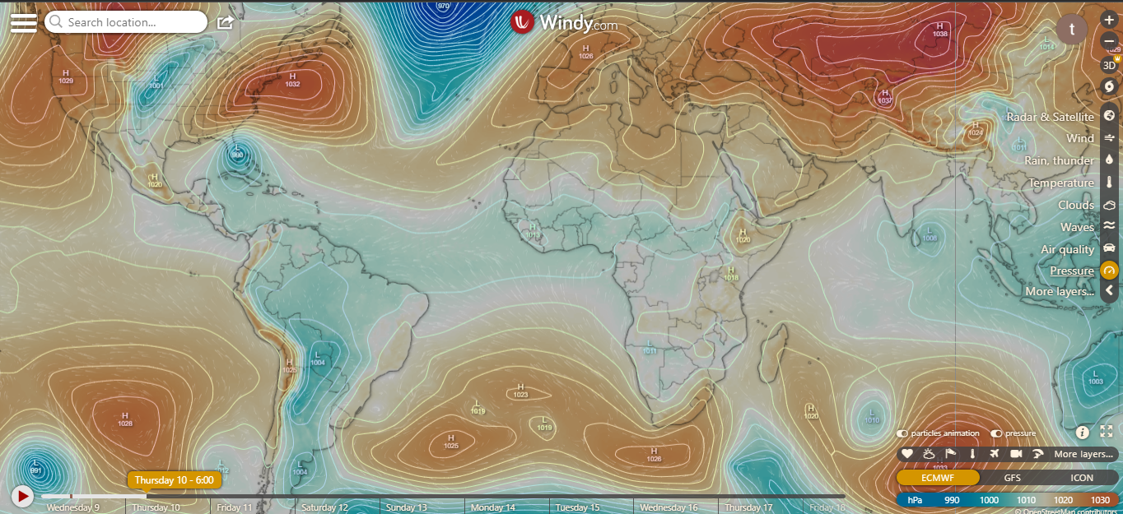
PRESSURE SYSTEMS @ 0600 UTC
1018hPa
1025hPa

Slide 9
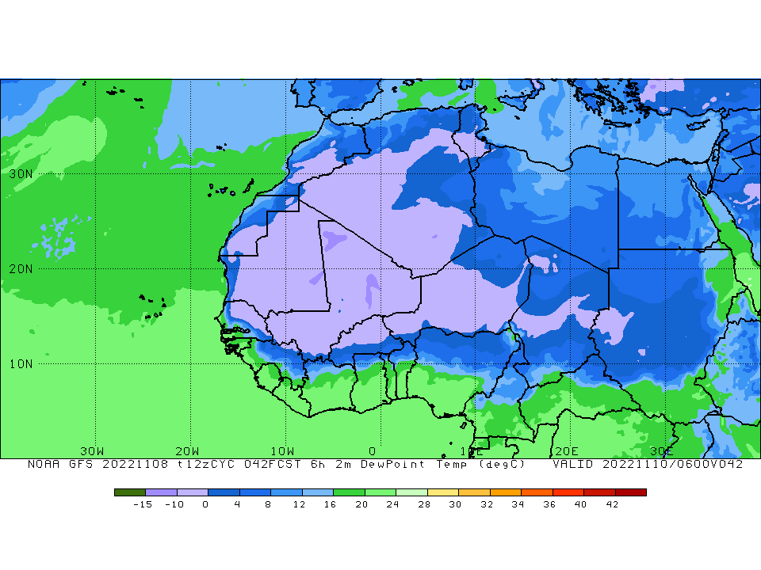
ITD POSITION @ 0000 UTC
7.8ºN

Slide 10
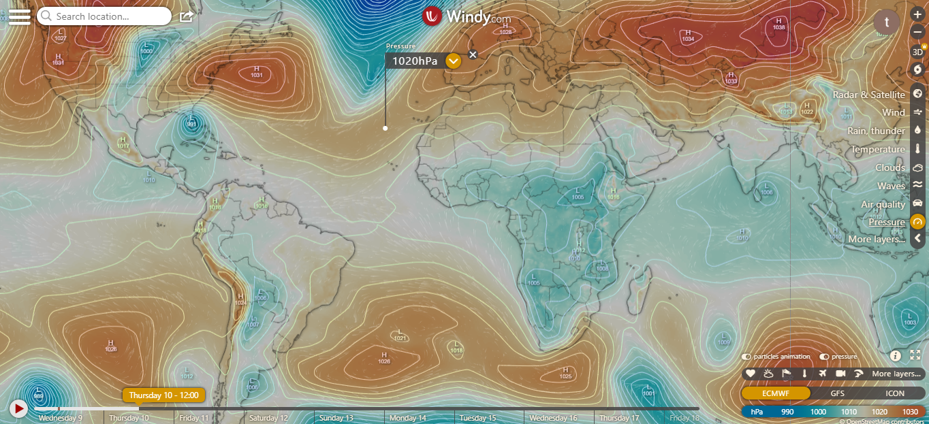
PRESSURE SYSTEMS @ 1200 UTC
1020hPa
1021hPa

Slide 11
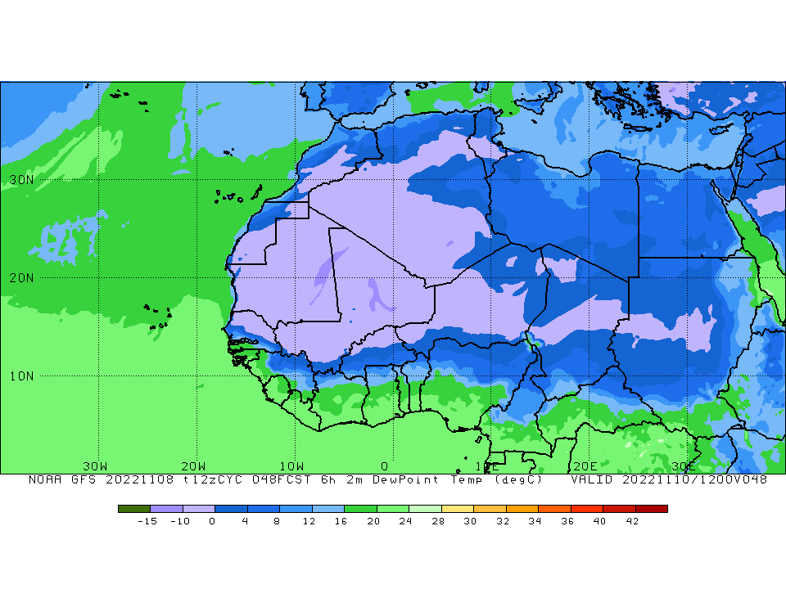
ITD POSITION @ 0000 UTC
7.2ºN

Slide 12
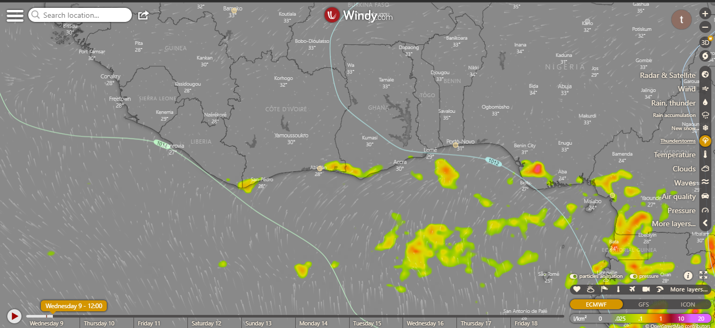
THUNDERSTORM @ 1200

Slide 13
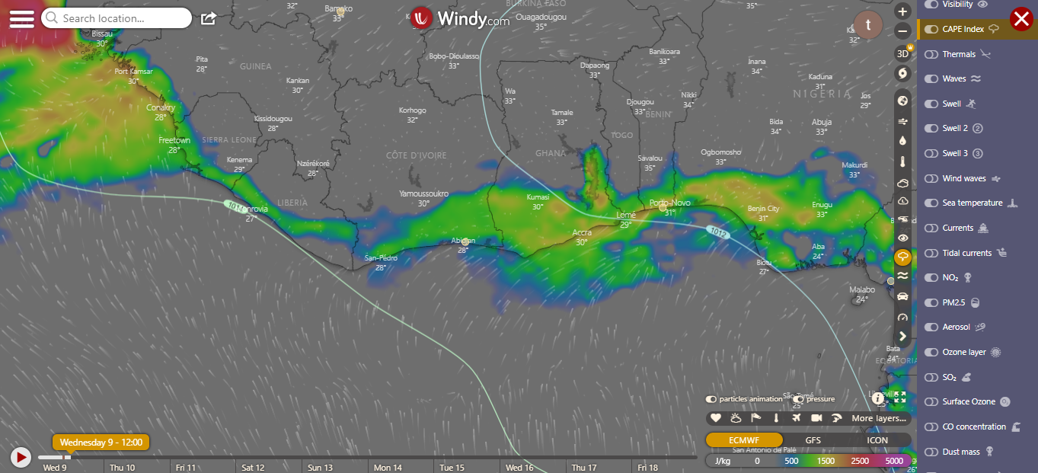
CAPE @ 1200

Slide 14
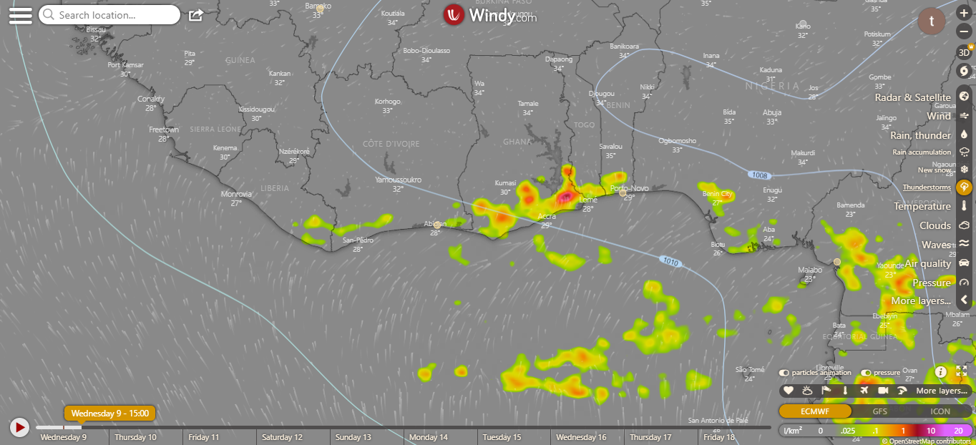
Thunderstorm @ 1500

Slide 15
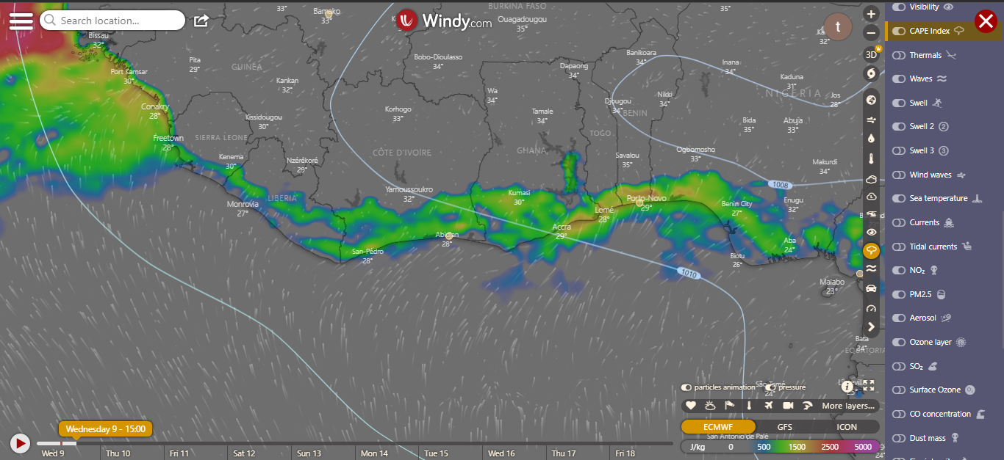
CAPE @ 1500

Slide 16
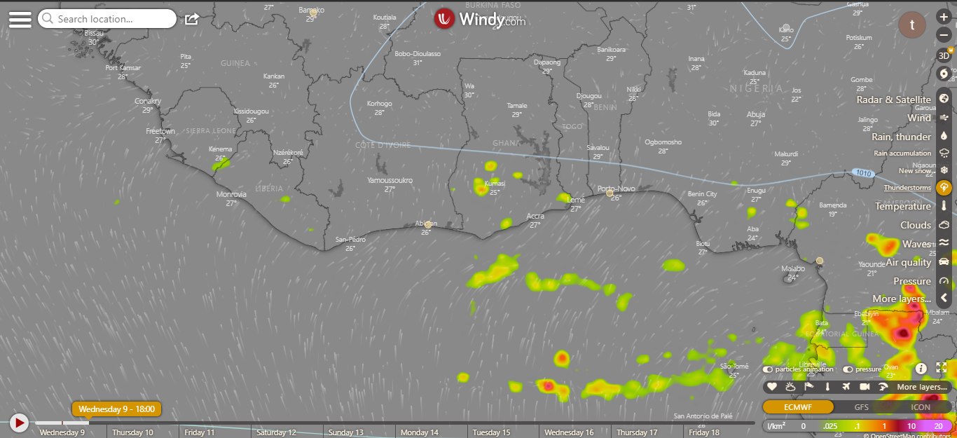
Thunderstorm @ 1800

Slide 17
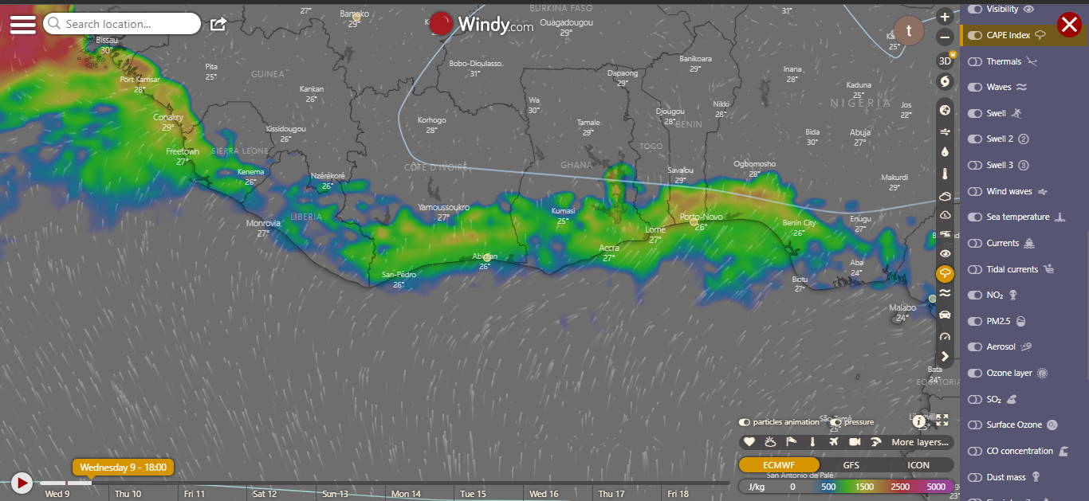
CAPE @ 1800

Slide 18
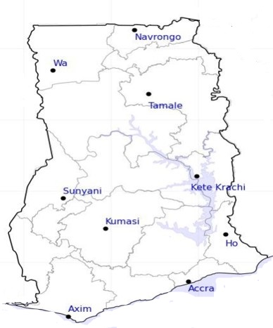

40
24-HOUR FORECAST
09-11-2022 @ 1200 UTC
34
RH AT DAY
[%]
54
52
70
67
78
72
80
83

Slide 19
44
24-HOUR FORECAST
09-11-2022 @ 1200 UTC
39
55
RH AT NIGHT
[%]
56
76
83
97
93
88
87

Slide 20
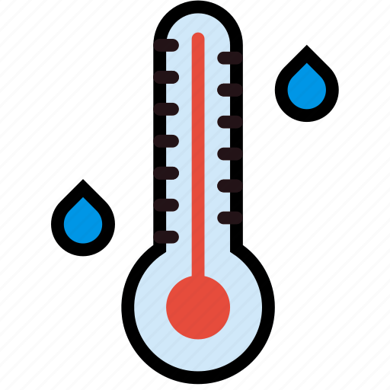
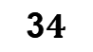
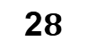
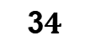
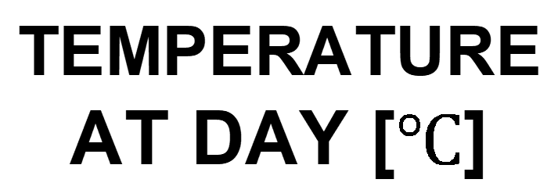
35
24-HOUR FORECAST
09-11-2022 @ 1200 UTC
3$4$
34
TEMPERATURE AT DAY [$℃$]
3$4$
32
32
29
30
2$8$
26

Slide 21
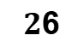
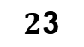
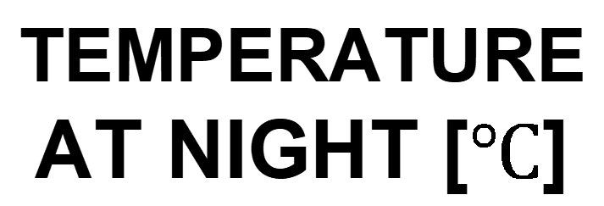
27
24-HOUR FORECAST
09-11-2022 @ 1200 UTC
26
TEMPERATURE AT NIGHT [$℃$]
26
$2$6
28
25
$2$3
24
26
26

Slide 22



GENERAL OUTLOOK
24-HOUR FORECAST
09-11-2022 @ 1200 UTC
Rain
Wind
Dust
PROBABILITY OF RAINS
20-30%
Low risk
Be aware
Be Prepared
Take Action

Slide 23
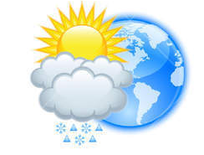


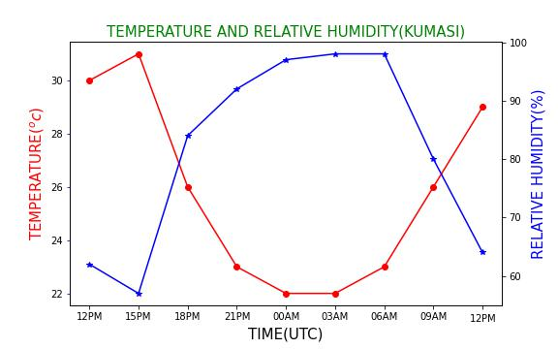


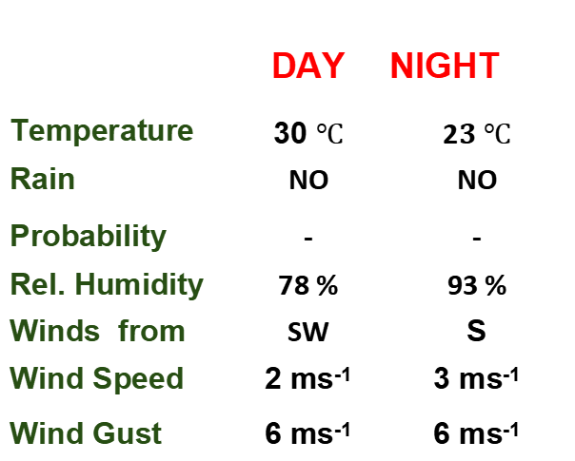
KNUST WEATHER FORECAST
24-HOUR FORECAST
09-11-2022 @ 1200 UTC
Rain
Wind
Dust
Forecast Summary (KUMASI)
 | DAY | NIGHT
Temperature | 30 $℃$ | 2$3 ℃$
Rain | NO | NO
Probability | - | -
Rel. Humidity | 78 % | 93 %
Winds from | SW | S
Wind Speed | 2 ms⁻¹ | 3 ms⁻¹
Wind Gust | 6 ms⁻¹ | 6 ms⁻¹
Low risk
Be aware
Be Prepared
Take Action
POWERED BY:
Department of Meteorology and Climate Science
, CoS
SUNSET: 05:46 PM SUNRISE: 05:56 AM

Slide 24


